Slide 1

Recipe Hub GUI and Design
Hot Topic
By Devon and tian

Slide 2
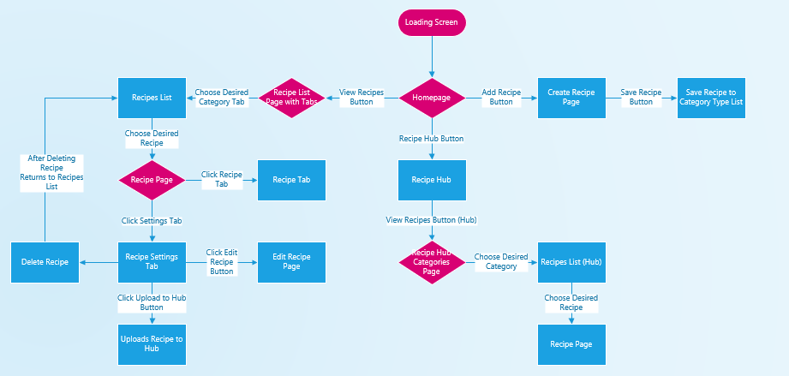
Navigation Diagram

Slide 3
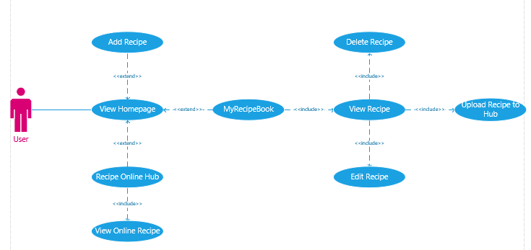
Use Case Diagram

Slide 4
Difficulties
New Environment – Android Studio
Biggest Difficulty would be to grab a recipe object within the local stored database and upload it to an online database.
Have different users view these online recipes.

Slide 5
Proto.io GUI Example:
https://share.proto.io/P02MVS/

